Slide 1

Find the best neighborhood for immigrants in Scarborough Toronto

Slide 2
Lots of people are migrating to various states of Canada and needed lots of research for good housing prices and reputated schools for their children. This project is for those people who are looking for better neighborhoods. For ease of accessing to Cafe, School, Super market, medical shops, grocery shops, mall, theatre, hospital, like minded people, etc.
This Project aim to create an analysis of features for a people migrating to Scarborough to search a best neighborhood as a comparative analysis between neighborhoods. The features include median housing price and better school according to ratings, crime rates of that particular area, road connectivity, weather conditions, good management for emergency, water resources both freash and waste water and excrement conveyed in sewers and recreational facilities.
It will help people to get awareness of the area and neighborhood before moving to a new city, state, country or place for their work or to start a new fresh life.

Slide 3
DataLink: https://en.wikipedia.org/wiki/List_of_postal_codes_of_Canada:_M
We use Scarborough dataset which we scrapped from wikipedia on Week 3. Dataset consisting of latitude and longitude, zip codes.

Slide 4
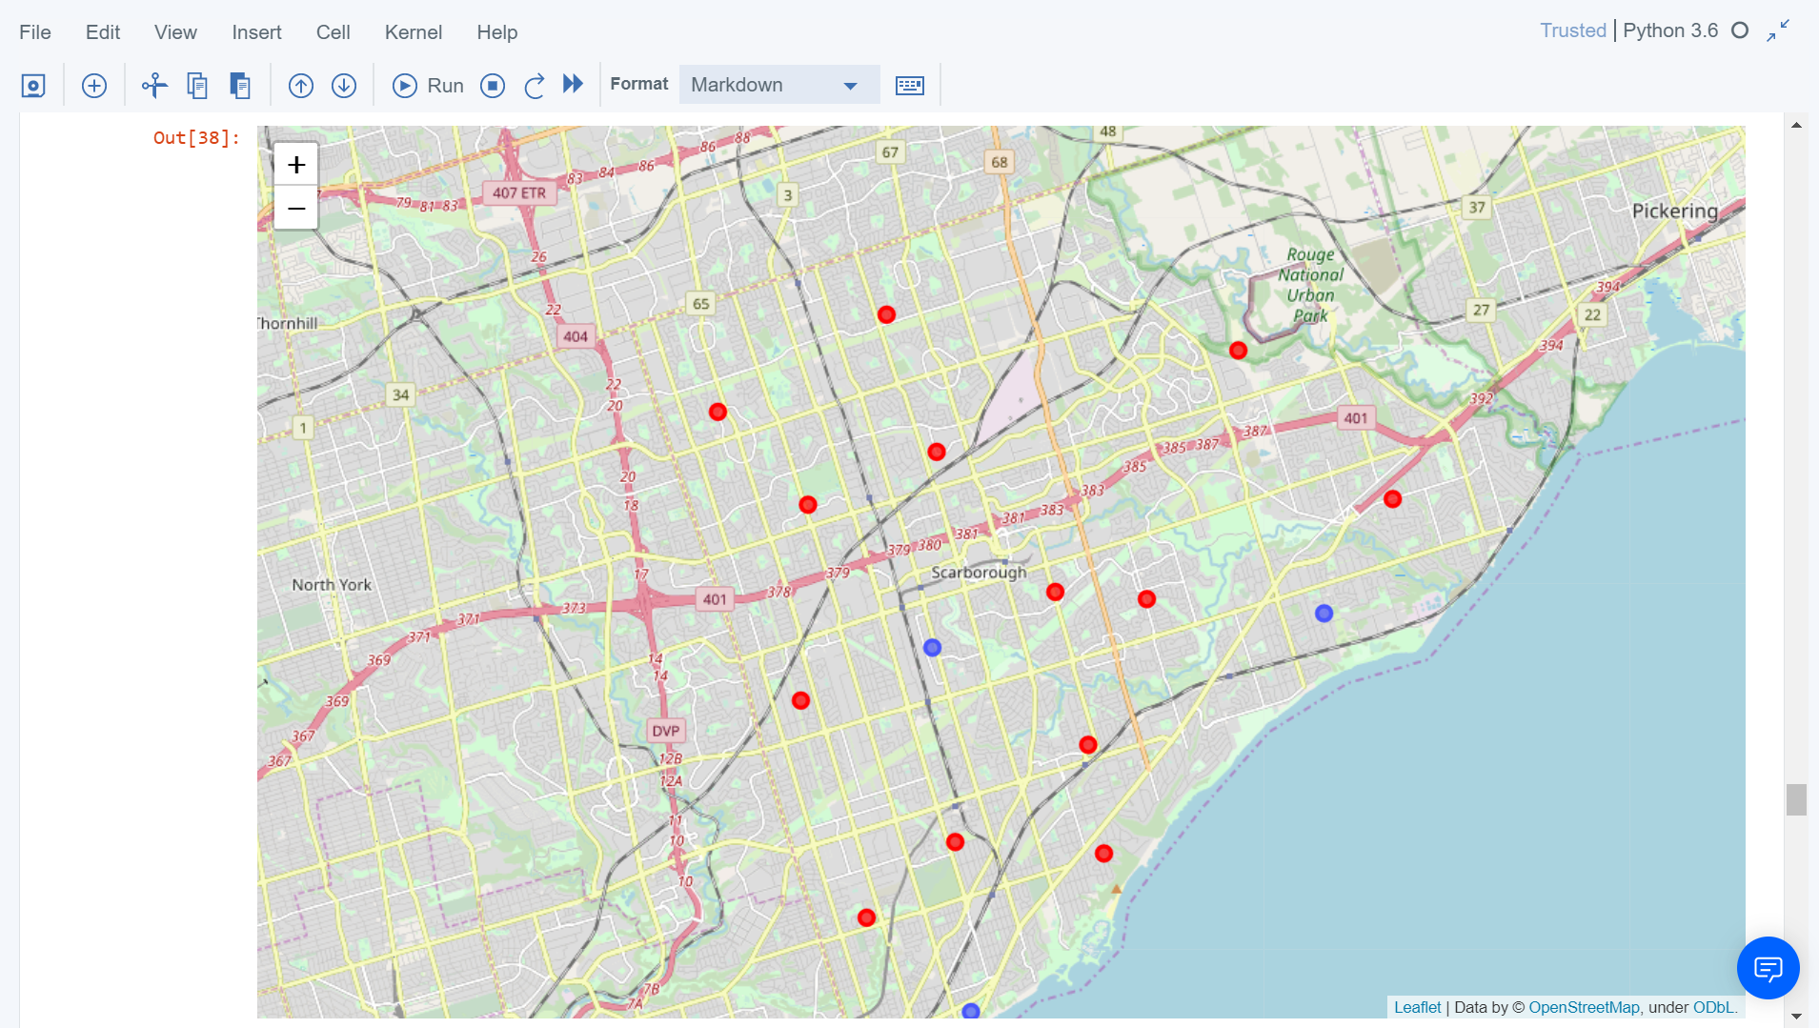
Map of Clusters in Scarborough

Slide 5
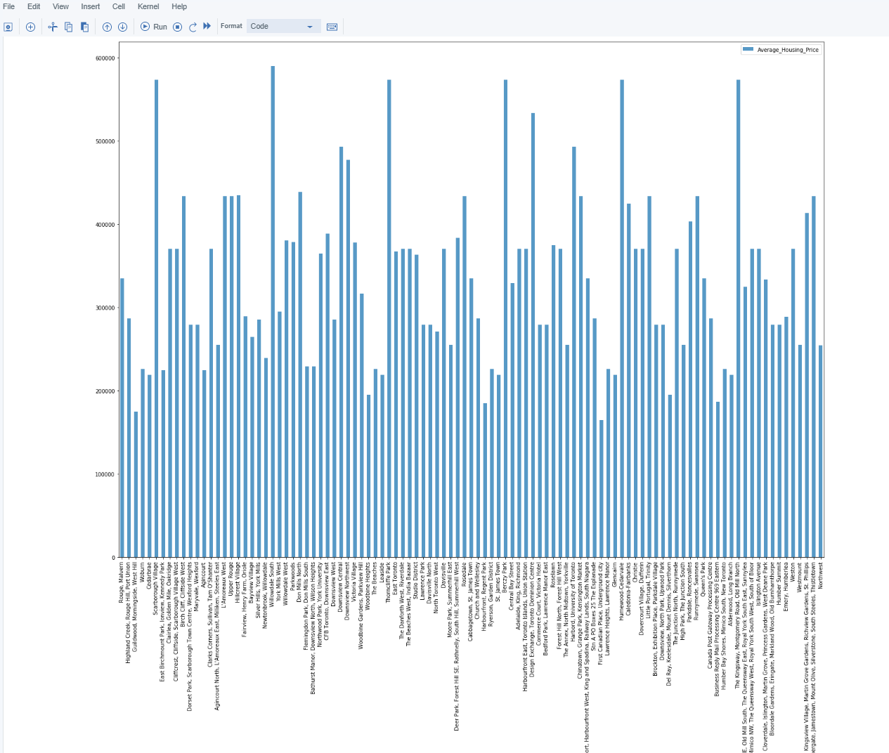
Average Housing in Scarborough

Slide 6
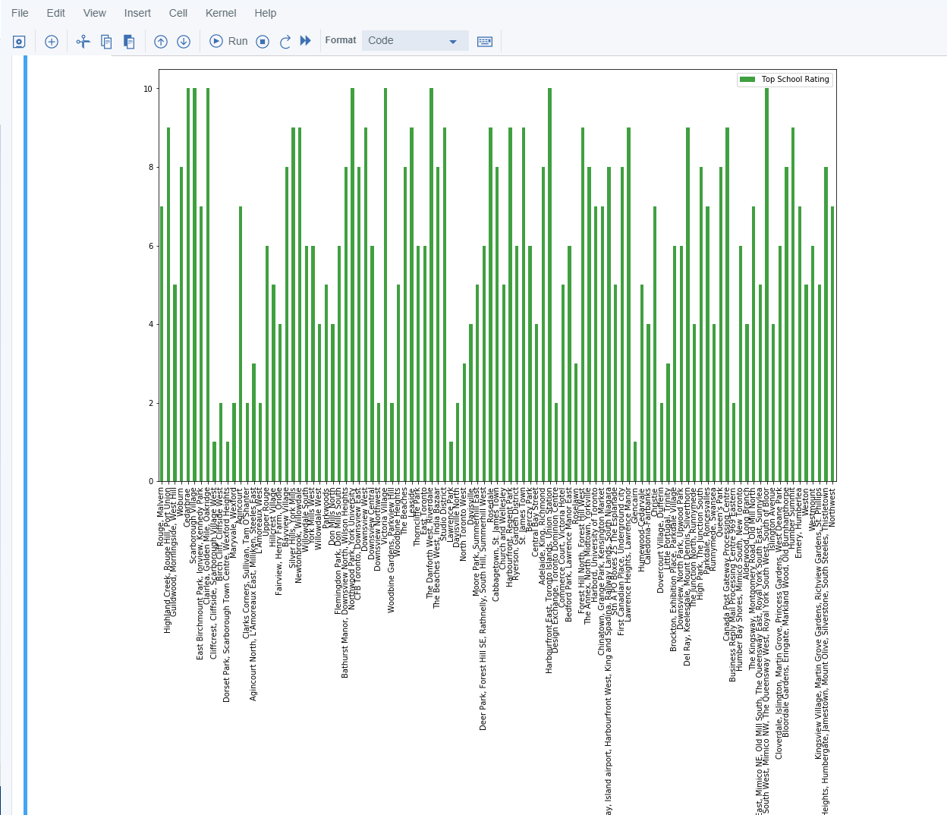
School Ratings in Scarborough

Slide 7
Conclusion
In this project, using k-means cluster algorithm I separated the neighborhood into 10(Ten) different clusters and for 103 different lattitude and logitude from dataset, which have very-similar neighborhoods around them. Using the charts above results presented to a particular neighborhood based on average house prices and school rating have been made.

